Slide 1
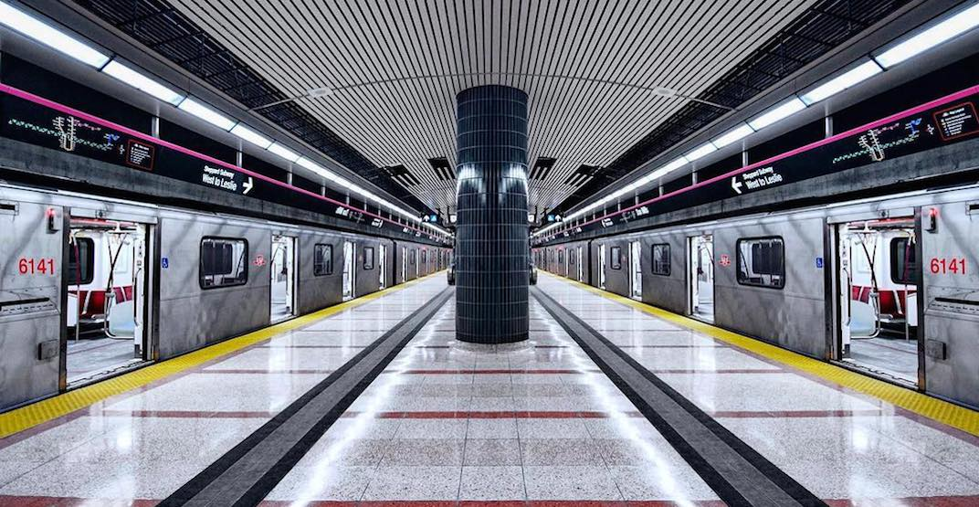

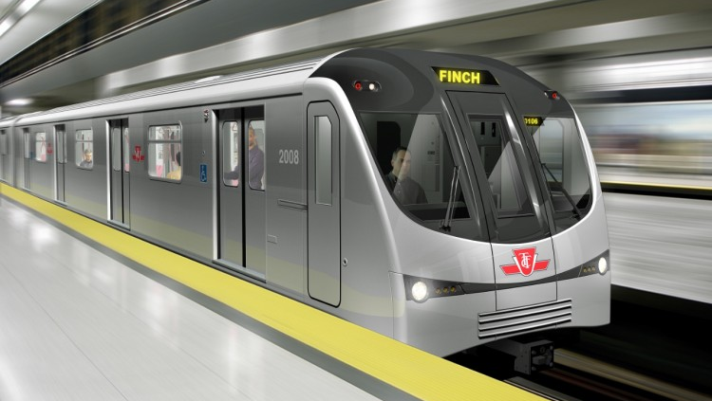
TTC Subway 2019 Delay Analysis
Ivy Fong
Jennifer Huynh
Nadia Iskandar
Shaohua Liu

Slide 2

Project Scope
Leaflet map
Map of Toronto and TTC subway stations with popups showing: name of station, subway line, and total number of delays in 2019, and average minimum delay in 2019
Plotly Line Graph
Showing relationship between time of day, average number of subway delays, and average delay minutes
Dropdowns to filter by Subway line, month, and day of the week
Plotly Line graph
Showing the relationship between day of week, average number of subway delays, and average delay minutes
Dropdowns to filter by subway line, month, and time of day

Slide 3

Data Sets
City of Toronto Open Data
TTC monthly subway delay data
https://open.toronto.ca/dataset/ttc-subway-delay-data/
Wikipedia (multiple web pages)
To get TTC subway station coordinates
e.g. Bloor-Yonge station:
https://en.wikipedia.org/wiki/Bloor%E2%80%93Yonge_station

Slide 4








Application Components
Cleaning Data
Database
Flask
Web
Dashboard Application
Sources:
https://open.toronto.ca/
Wikipedia
Uploaded to PostgreSQL at Heroku with Pandas
Python Flask generate Json
https://ttc-2019-delays.herokuapp.com/
Multiple Raw Files to 2 Clean files

Slide 5




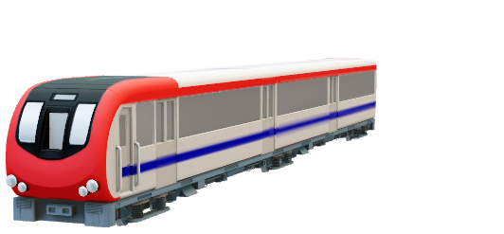
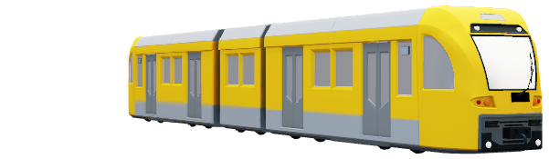
Service frequency
During rush hour, up to 65 trains are on Line 1 simultaneously, 45 trains on Line 2, 5 trains on Line 3, and 4 trains on Line 4. During non-rush hour periods, there are 30-46 trains on Line 1 at any one time.
Line | Off-peak frequency | Rush hour frequency
Yonge–University | 3.5–5 minutes | 2–3 minutes
Bloor–Danforth | 3–5 minutes | 2–3 minutes
Scarborough | 6-7 minutes | 5 minutes
Sheppard | 5.5 minutes | 5.5 minutes

Slide 6
Service frequency
During rush hour, up to 65 trains are on Line 1 simultaneously, 45 trains on Line 2, 5 trains on Line 3, and 4 trains on Line 4. During non-rush hour periods, there are 30-46 trains on Line 1 at any one time.
Line | Off-peak frequency | Rush hour frequency
Yonge–University | 3.5–5 minutes | 2–3 minutes
Bloor–Danforth | 3–5 minutes | 2–3 minutes
Scarborough | 6-7 minutes | 5 minutes
Sheppard | 5.5 minutes | 5.5 minutes

